Slide 1
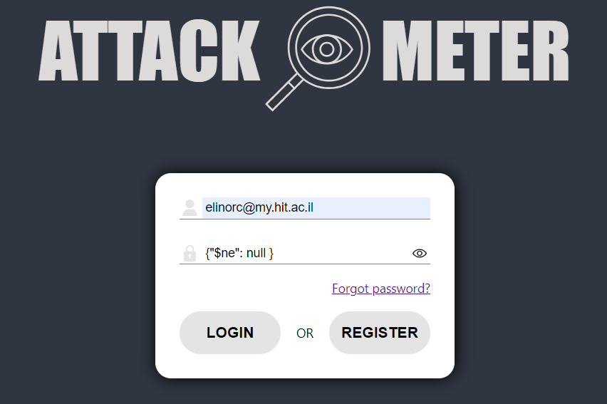
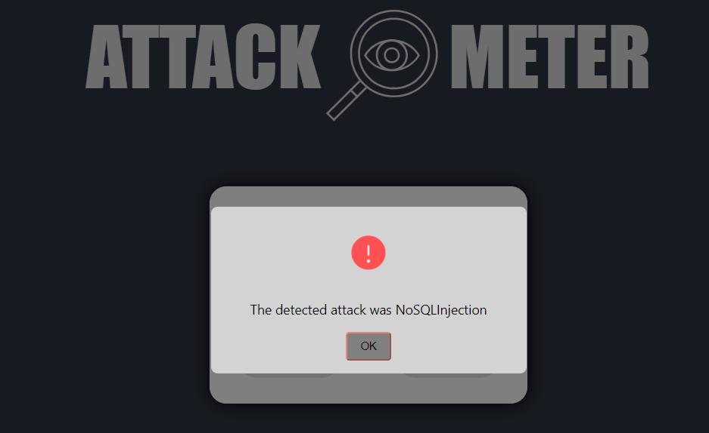
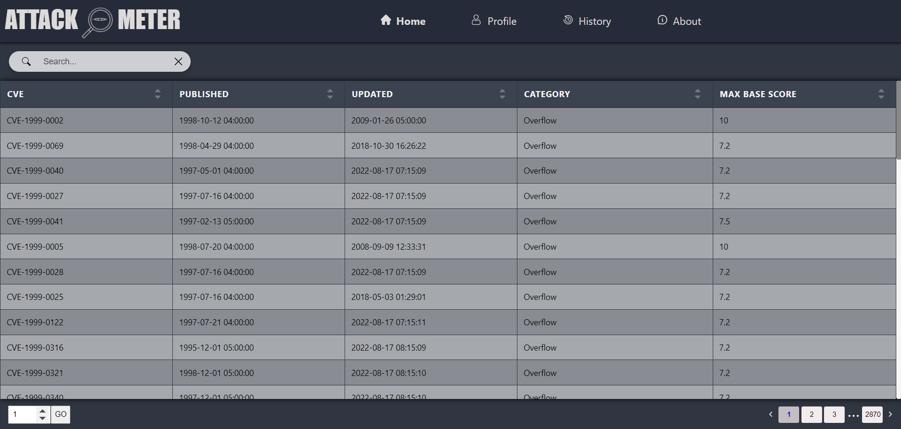
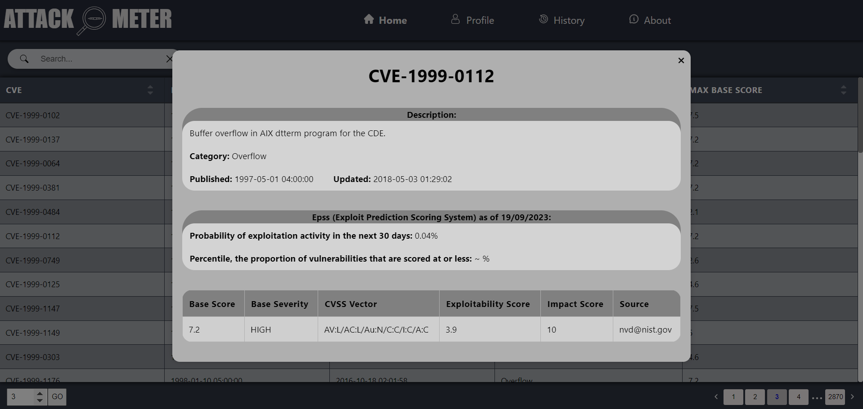
Cyber attack detection engine | Cyber attack detection engine Shon Khundiashvili, Elinor Cohen, 2023, summer semester –תשפ"ג, סמסטר קיץ
Roy Zimon
Introduction
Organizations face numerous security threats in the digital landscape, including cyber attacks, data breaches, and insider threats.
Project’s purpose
The project was done for the purpose of learning that any person can log into his user and try different attacks on the site. The site will identify these attacks and display an appropriate message to the user according to the attack carried out
Development
The code was developed using JavaScript and Python. The server side was developed using NodeJs, the client side was developed using ReactJs. Each page on the site has a different logic. You can run and test all the attacks that the site knows how to deal with such as NoSqlInjection, CSRF, XSS The site will detect an attack and notify the user of the attack that was carried out
NoSQL Injection Example
Drive Link
Exploits data table
Exploits & Vulnerabilities
Exploit/Vulnerability details

