Slide 1
SMART CAMPUS
FULL STACK PROJECT
DB MIGRAITON
By Nadav Gvili

Slide 2
DESCRIPTION
A real-time system with an interactive web interface that allows users to manage the campus facilities.
This projects extends the scope of a previous project to more sensors and capabilities.

Slide 3
Development Environments and Languages

Slide 4
STAKEHOLDERS
Campus Visitors- improving visit’s accessibility and quality.
Campus Lessees- fast and accurate management oprations. Improving organization conditions and lessees’ satisfaction.
Organizational Management Level- provides accurate statistics on organizational habits.

Slide 5
FACILITY MONITORING
Air pollution
Parking monitor
Chiller control
Class occupancy
Visitors counter
Sprinkler control
Water meter
Electricity meter

Slide 6
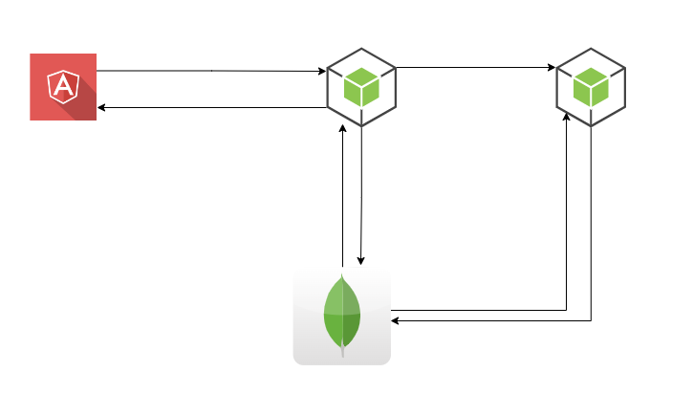
ARCHITECTURE SHIFT
Smart-campus-FE
Smart-campus-BE
Smart-campus-modbus
mongoDB

Slide 7
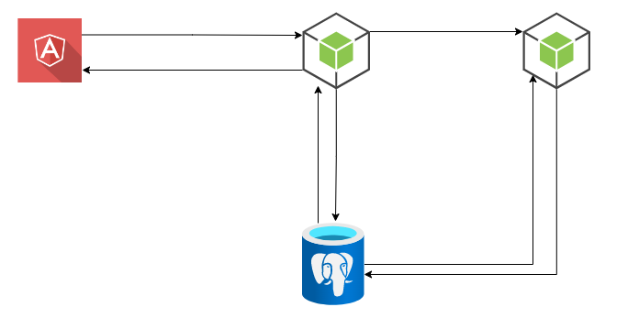
A new PostgreSQL server was created
Data migration with HEVO
Smart-campus-FE
Smart-campus-BE
Smart-campus-modbus
postgreSQL

Slide 8
mongoDB with Mongoose package
Working with Mongoose package
No-SQL syntax
JSON Schema convention
Model
Service
Schema
Connection pool

Slide 9
Sequelize package
Working with Sequelize package
Relational DB and SQL syntax
Models contain bot Mongoose’s schemas and models
Model
Raw Query
Connection pool

Slide 10
Tables
Users
User_roles
Locations
Reports
counters
chillers
Device_types
devices
Auto_increment

Slide 11
Recommendations
The solution showcased in this project can be easily replicated easily to all fields and future tables.
When applying additional sensors to the campus or any SMB it is preferable to use relational DB topology. This way the data is easily processed to ML and BI ends.
Further ML and BI features should be written in python.

Slide 12
Git
Link: https://git.pblm.tech/smartcity/smart-campus

