Slide 1
Maintenance project
Developed by: Yosef Cohen, Idan Rotshtein, Eran Kimchi, Tomer Gat, Yuval Shavit, Carmel Isaac, Michelle chorny
Mentors: Tal Gomai & Mark Israel

Slide 2
introduction
The field of routine maintenance is a field that occupies a significant share of the organization's expenses.
Routine maintenance is the most efficient way to ensure the safety of use and the integrity of the installed equipment.

Slide 3
Project Purpose
Creating tasks and managing them in an organized interface refers to the process of using software or an app to create and organize tasks or to-do items. This can include adding details such as a task description, due date, and priority level.

Slide 4
User types
Administrator
Manager
a user who can provide alerts to users to perform maintenance, set up maintenance lists, define and create a knowledge library, view the information collected, and perform database questioning.
a user who can manage system usage credentials and user approval.
Maintenance man
a user who registers for the system, receives a list of maintenance tasks and indicates the execution of the tasks. The user will be able to enter comments and add photos if necessary.

Slide 5
Administrator functionality
That user will have the ability to add new users with specific permission (maintenance\manager\administrator) – for new employees.
That user can delete users for the system.
Users can update permission to existing users, in case employees are promoted.

Slide 6
Manager functionality
On the main page see all open missions to his day
Users will assign any mission to maintenance users base on their availability, location, and skills.
On another page User will review all failed missions & figure out how to fix them – Re-assign to relevant users.
User add & update Knowledge page that contains all maintenance missions that include all subtasks to each mission, Tools that needed to be complete, User guide to new employees, etc.

Slide 7
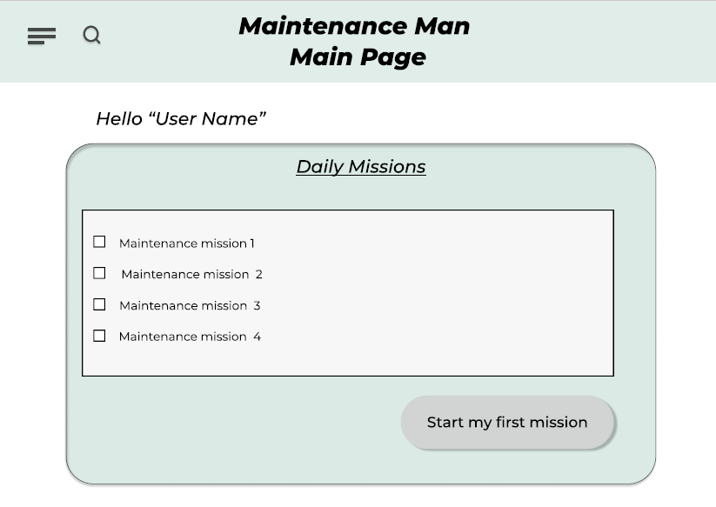
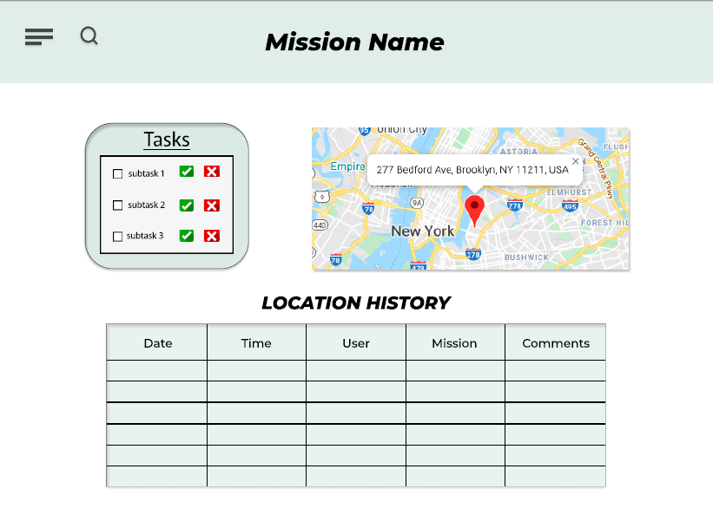
user functionality
On the main page, the user will see all of his daily missions by the order of their arrival.
When clicking on the "starting first mission" button, the system will navigate the user to the mission's location.
The user can check all of the subtasks.
Users will repeat this process for the rest of the day or when all the missions are accomplished.

Slide 8
Usage & Functionality

Slide 9
Add new user
The code:
The interface:

Slide 10
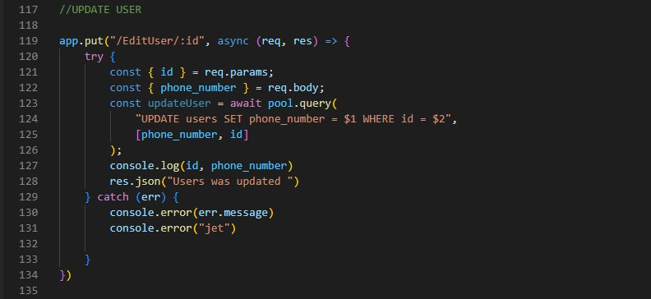
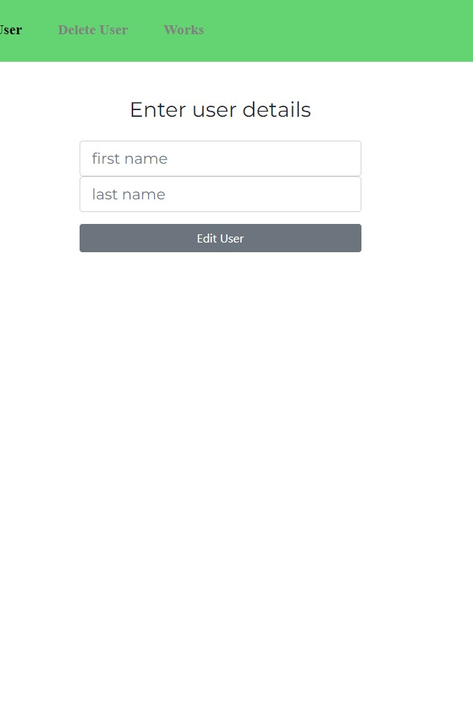
Update user
The code:
The interface:

Slide 11
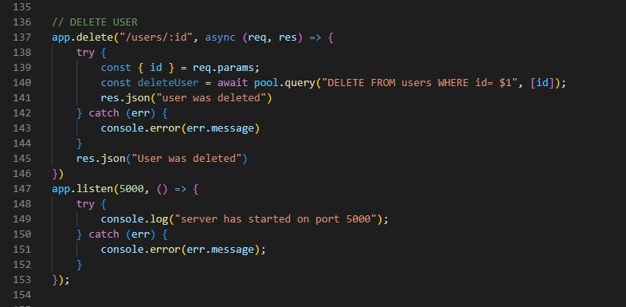
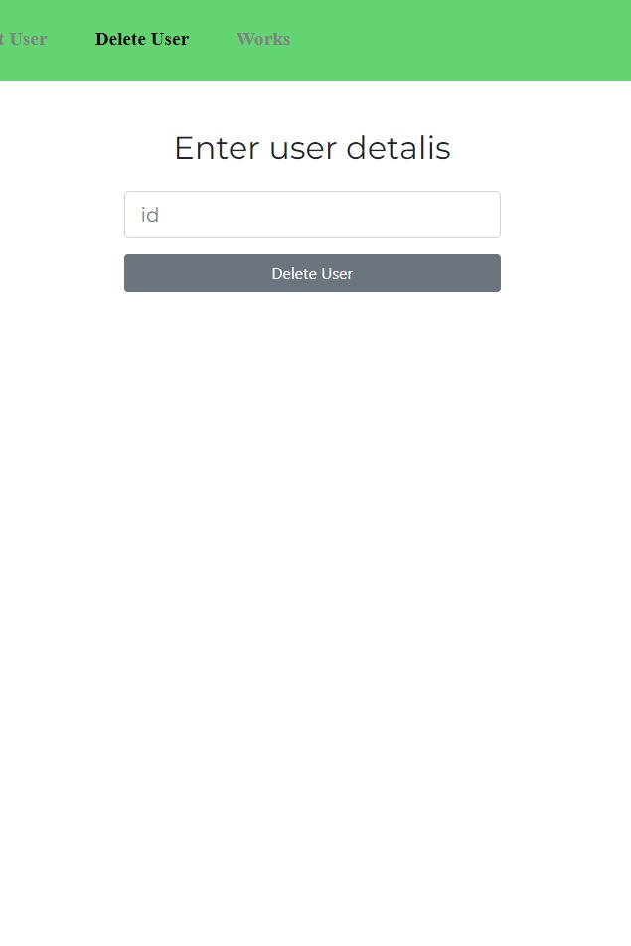
Delete user
The interface:
The code:

Slide 12
Add a new task
The interface:
Once tasks are created, they can be organized into different categories or projects. The tasks can then be viewed in a variety of ways, such as by date or priority level. These tools also allow users to create tasks, organize them into different projects, assign them to team members, and track progress.
The code:

Slide 13
Validations & processes

Slide 14
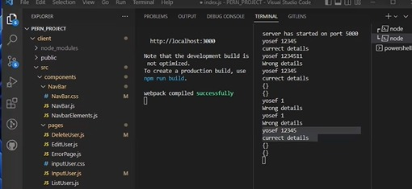
This is an example of login process validation:

Slide 15
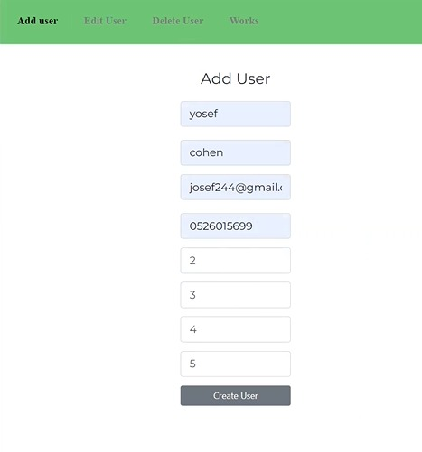
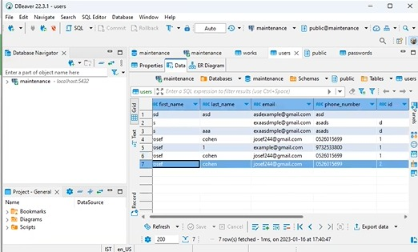
This is an example of adding a new user:

Slide 16
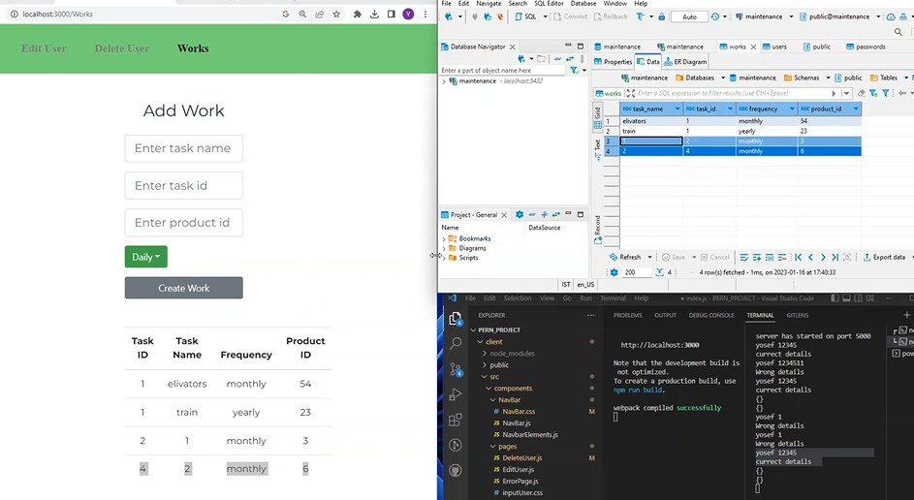
This is an example of adding a new task:

Slide 17
The structure of the database

Slide 18
Summary of the project
We created a project to manage ongoing maintenance that includes all the tasks for the maintenance person, the application includes various functions such as tracking tasks - if the task performed correctly, on time, and all this in collaboration with the project manager who can follow his employees and manage them in an optimal way.

Slide 19
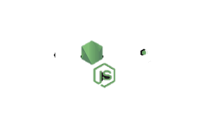
Languages, Frameworks & Libraries

