Slide 1
Final project in
Electrical and electronics engineering
Smart home controlled by BOT
Computer Science B.S.c
Adar Kabada 313296279 Gila Aweke 320430218
The project lecturers: Yuri Yurchenko

Slide 2
BACKGROUND
In the past, installing a smart home system was very expensive, complex and required hiring the services of a company that specializes in it. In the digital age we live in, users are looking for maximum convenience, speed and efficiency when consuming products and services.
Smart control of smart home products may even contribute to the efficiency of their operation and savings in the home consumption.Today, most smart home systems are controlled by smartphones and microcontrollers. Smartphones are used to control and monitor home functions in wireless communication techniques, but this solution is usually based on using a cloud that is outside the monitored home which can lead to security breaches and loss of control. We intend to implement the concept of a smart home with a combination of IOT services and cloud computing, by implementing information in sensors and actuators with the help of a tiny computer and networking of smart components using the MQTT communication protocol. Furthermore, we will create ease of management and interactions with the smart devices through speech recognition technology implemented on BOT.

Slide 3
OUR GOALS
• Develop a cost-effective and user-friendly smart home system: The goal is to overcome the previous barriers of expense and complexity associated with installing a smart home system. The aim is to create a solution that is affordable, easy to set up, and accessible to users without requiring specialized assistance.
• Ensure privacy and security: Addressing the security concerns associated with cloud-based smart home systems, the aim is to prioritize privacy and data protection. By utilizing IoT services and cloud computing in a secure manner, the system should safeguard user data, prevent unauthorized access, and maintain control within the home environment.
• Implement MQTT communication protocol: The goal is to establish a reliable and efficient communication network among smart components using the MQTT protocol. This will facilitate seamless data exchange and coordination between different devices and enable real-time monitoring and control of the smart home system.
• Integrate speech recognition technology on BOT: To enhance ease of management and interaction with smart devices, the project aims to implement speech recognition technology on a BOT. This will allow users to control and interact with their smart home devices using voice commands, providing a hands-free and intuitive user experience.

Slide 4
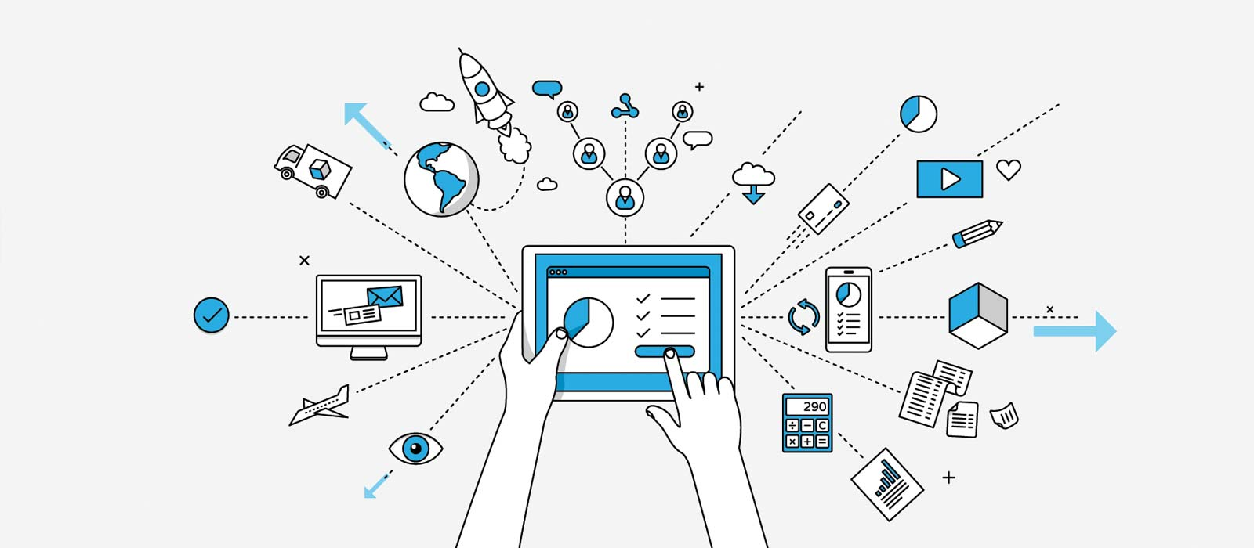
IOT
The term "IOT" stands for "Internet of Things," which refers to a network of physical objects connected by electronics, software, and sensors to facilitate data exchange and communication. This network has the potential to bring automation in various fields, including smart homes, smart cities and more. In the context of smart homes, IOT technology can enable communication between home appliances, enabling remote control using a mobile device. For example, using a smartphone, you can adjust the temperature of the air conditioner or open and close blinds. IOT technology can also enable the integration of different devices, providing a smoother and more efficient user experience.

Slide 5
History
In 1982, the idea of connecting a device to the Internet was first introduced when a Coca-Cola vending machine was connected to the network at Carnegie Mellon University in Pennsylvania. The machine was able to send updates about its inventory and the temperature of the beverages it contained. This innovation ignited the concept of the Internet of Things (IoT) and prompted other companies to explore this area. Momentum for IoT began to grow in 1999 when Bill Joy, an American computer scientist, introduced the idea of communicating products over the Internet. Since then, IoT has become an integral part of the modern technological landscape and has the potential to revolutionize various fields such as healthcare, transportation and agriculture, among others.

Slide 6
Product development
To develop an IOT product, all devices in the home will be connected to the same local area network (LAN) through a unit called LAN Manager, which serves as a communication pool to forward requests to the appropriate destination - the home's information server and database. The server will be responsible for all activation commands of the devices. When developing IoT products, it must be taken into account that the devices in the home can be diverse and come from different suppliers, so it is necessary to ensure that the devices speak the same language or protocol. Also, important
Plan the structure of the network and ensure a high capacity of the network at every point in the house to make sure that the devices can communicate appropriately and in real time.
In addition, security and privacy issues must be considered when developing IoT products. The devices in the home contain sensitive information about the residents and their lifestyles, so it is important to ensure that this information remains safe and protected against hacks and cyber attacks. IoT product developers should consider advanced security capabilities such as exposing the information according to the node structures, effective identity verification and viewing operation history to identify suspicious operations.

Slide 8
Product development
After presenting the function of a smart home, we will demonstrate the differences between the IoT scenarios and the familiar Internet scenarios. We will illustrate this through a series of scenarios:
1. In the first scenario, burglars try to enter the house and gain access to the interior space. In this case, if the burglars enter through the door, the smart lock system will detect unusual activity and notify the home owners. In the case of an attempted break-in through the windows, the movement and depth sensors will detect unusual activity and send a message to the home owners to intervene and help prevent the break-in.
2. In the second scenario, it seems that the movement and depth sensors of the smart home save the situation. When burglars try to break into the house, the sensors detect the movement and activate an alert procedure for the home owners. A quick and appropriate response saves the house from a burglary and allows the home owners to take appropriate action to prevent further damage.

Slide 9
Product development
3. The problem of opening and locking the house requires an examination of all the devices in the house as well as the possibility that one of them could break in the process. A simple solution could be an IOT product that would allow the user to activate the command to lock the house from anywhere and thus provide the solution to this problem. The device can receive the command to lock the house through MQTT which will serve as a protocol for communication between the devices.
To manage the temperature and light in the home, the LAN Manager can share weather information with all devices as well as the information on the amount of light and its direction depending on the weather. In this way, the devices can adapt to the environmental conditions and provide a comfortable weather experience for the residents of the house.

Slide 10
MQTT (Broker)
An MQTT mediator, also known as Broker, is the central player in the MQTT protocol. The main role of the broker is to receive all the messages sent by the devices connected to the network, filter them according to the appropriate topics and decide which customers should receive the messages. Eventually, the broker publishes the notices to all customers registered for the respective topics.
With the help of the MQTT protocol, device networks can be created through the intermediary, and advanced IoT solutions can be built. The MQTT broker allows devices to publish data and register as subscribers to various topics in an efficient and easy way. The broker also allows remote operations to be activated on the devices, for example turning on the lighting in the room or turning off the air conditioner.
In order to connect to the MQTT broker, the clients use the TCP/IP communication protocol. All messages sent between the clients and the broker are encrypted using SSL/TLS, which provides a high level of security for communication.

Slide 11
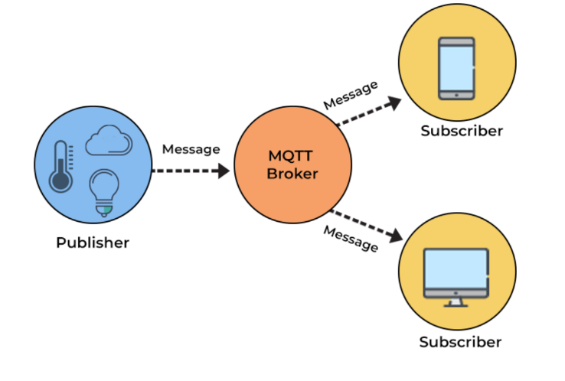
MQTT (Broker)

Slide 12
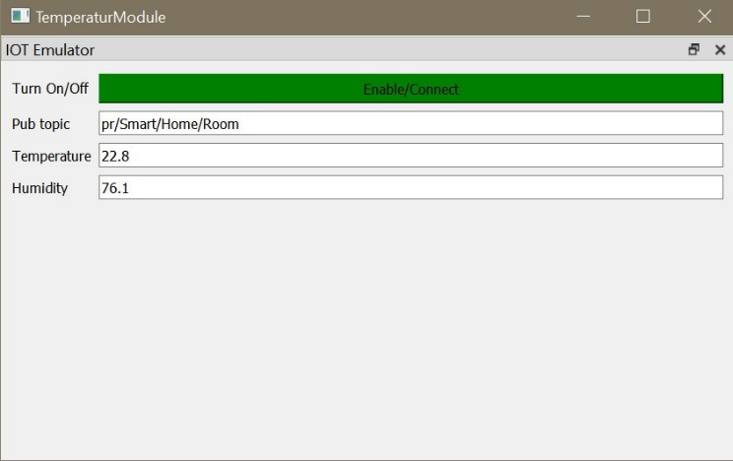
Emulators
Emulation is the ability of software or hardware to imitate the behavior of other software or hardware. In our project, we created emulators that simulate sensors and system components, to allow us to test the system efficiently and accurately. In order to create extreme situations, we needed to test the system in different environments, and the use of emulators allows us to create environments adapted for this purpose.
To reach this result, we used emulators that simulate sensors and system components. For example, we created emulators for electricity and water consumption meters, water heaters, air conditioners and temperature and magnetic sensors for doors and windows. In Figure 30, you can see an emulator that simulates a temperature sensor in a room. The fields available in the emulator include options for turning on and off, Topic details, temperature and humidity. The use of emulators allows us to test the system accurately and create extreme situations for the purpose of testing the system.

Slide 13
How to transfer the information from the emulator to the system:
Here we describe the way in which the information is transferred from the emulator to the system: the emulator publishes information continuously to the MQTT Broker using the MQTT communication protocol. The MQTT Broker we use is HiveMQ, an MQTT-based messaging platform designed for real-time updates. This platform is efficient and reliable in transferring data from IoT devices connected to it. In order for the emulator and the MQTT Broker to be able to communicate with each other, they must be under the same IP address and under the same port, and of course be registered to the same Topic.

Slide 14
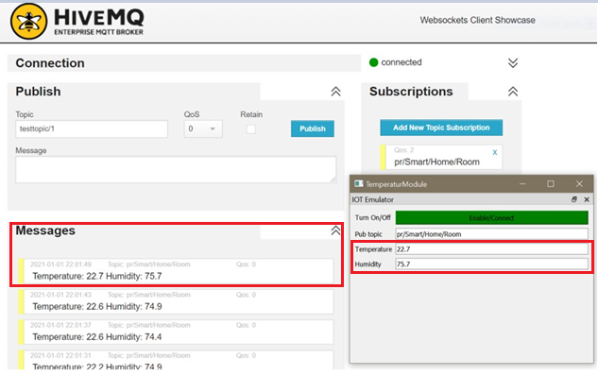
How to transfer the information from the emulator to the system:

Slide 15
GUI
The IoT smart home GUI typically consists of a central control panel or dashboard, which displays real-time data and allows users to adjust settings or activate functions for each device. The dashboard can be accessed via a mobile app, a web-based interface or a dedicated control panel device installed in the home.
One of the advantages of an IoT smart home GUI is that it can be tailored to the user's specific needs and preferences. For example, the dashboard can be designed to display only the devices most important to the user, or to highlight certain information such as energy usage or security alerts.
The connection between GUI and HiveQM lies in the role that a graphical user interface can play in facilitating data analysis and process control. A well-designed GUI can provide real-time access to data from various sensors and control systems within a manufacturing facility, allowing operators to monitor key process variables and identify potential quality issues.

Slide 16
GUI

Slide 17
Testing data transfer between the BOT and Data storage (SQLite)
In Figure 35 you can see the SQLite window before the BOT request to turn on the air conditioner and set it to a certain temperature. In the SQLite window you can see the table of air conditioners and the values found in each of the columns of the table. You can also see the "special" column of the air conditioner describing the state of the air conditioner, when the value is "changed" and not "done",
The air conditioner is not turned on and is not set to a certain temperature.

Slide 18
Testing data transfer from the BOT to the emulator
Having identified that the emulators are communicating with the data storage (SQLite) successfully, we now need to test the data flow between the BOT and the emulators using the MQTT server. To check this, we will send a voice command to the BOT to turn on the air conditioner in the room and set it to a certain temperature, and we will want to make sure that the air conditioner turns on and the temperature corresponds to our request.
In Figure 37 you can see the emulator and the manager before the request. Now, we can send the voice command to the BOT and check the emulator's response to our request

Slide 20
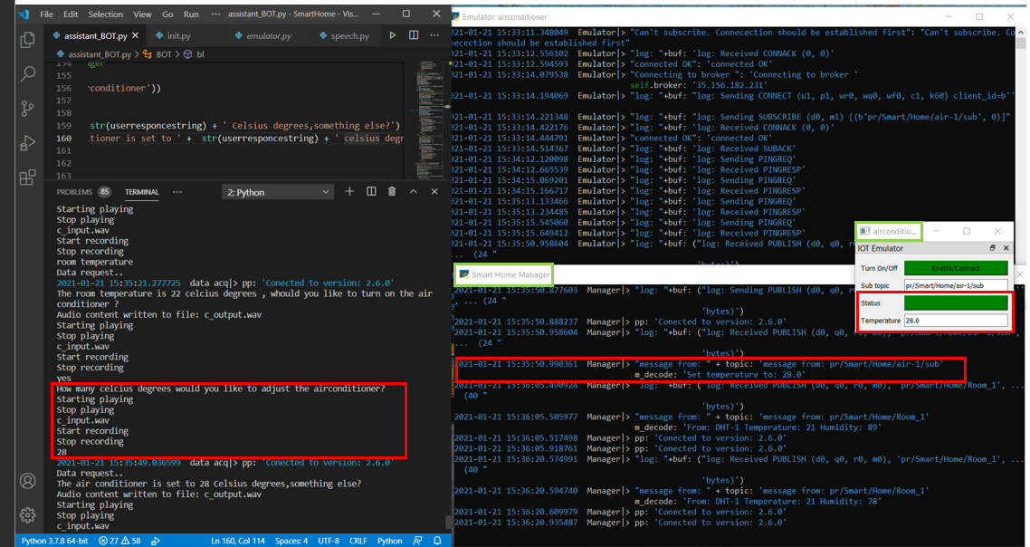
In picture 38 you can see that the air conditioner was turned on and put into operation in order to adjust it to the temperature requested by the BOT. In the CMD window of the Manager you can see that the message about the direction of the temperature in the air conditioner to the requested value was sent successfully. That is, the system issued a positive response and we have successfully provided our request.

Slide 21
System function test in scenario number 2
In scenario number 2, we tested the functioning of the system in the scenarios of the BOT's request to turn on the air conditioner and set it to a certain temperature.
During the scenario, you can see in Figure 39 two emulators running simultaneously. The first is Smart Home Manager, which simulates the management interface of the smart home and includes the system database containing tables of the rooms and devices in each room and their current status.
The second emulator is Assistant BOT, which simulates the BOT interacting with the user. When the user asks the BOT to turn on the air conditioner and set it to a certain temperature, the request is sent to the Smart Home Manager and the device table where the air conditioner is located.
You can see in Figure 38 that the air conditioner was turned on and set to the requested temperature and in Figure 40 you can see the confirmation message sent to the BOT with the details of the request and the operations performed on the air conditioner. Thus, thanks to the communication between the BOT and the Smart Home Manager, the system was able to perform the operation successfully and set the air conditioner to the desired temperature.

Slide 22
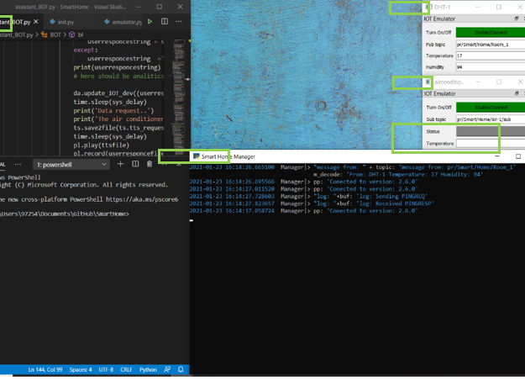

Slide 23
Checking reports on unusual events
As part of the test carried out, it was found that the system manages to identify unusual events and report them through the MQTT system. The simulation was shown using an emulator that shows a higher than usual consumption of water and electricity. As the output becomes abnormal, the system manages to detect the event and notify about it via the MQTT. You can see in the pictures that the report reached both the computer and the mobile phone, which shows the ability of the system to adapt to a wide variety of devices and platforms. The test shows that the system works properly and is able to identify and report events

Slide 24
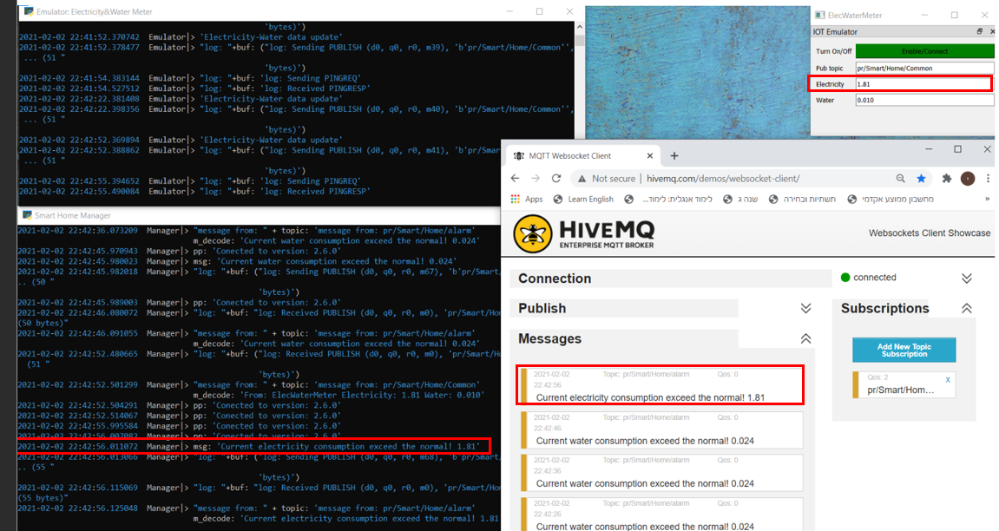

Slide 25
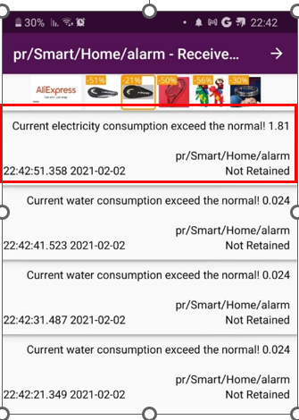
As part of testing a report on higher water consumption than usual, we recommended a situation where the user operates a washing machine and uses the shower and in their combined use, you can see in the pictures that the MQTT report is waiting for the consumption data to be sent and when the consumption rises above the certain threshold, a report is made on HiveMQ and on the mobile phone . You can see the emulators that work in parallel and the form of reporting that comes from the MQTT in the attached images. So this test also received a proper report and managed to raise the event alert to system users.

Slide 26
Analysis of the results and summary
In the experiments carried out, the ability of the system to solve a central problem in the management of home IoT devices was proven, by managing the smart home through a central computer controlled by the BOT and by being able to transfer data and commands between the various components of the smart home and the BOT.
The experiments included testing various scenarios such as reporting on temperature and controlling the air conditioner, reporting on electricity consumption and also tests on unusual events and their identification. The scenarios were carried out with proper interfacing and data transfer between all connections integrated into the system.
The experiments proved that the system is able to identify unusual events and report them, as planned in advance. In other words, the system was able to automatically detect unusual events such as higher than usual electricity and water consumption and send reports about them via MQTT to both the computer and the mobile phone.

Slide 27
Analysis of the results and summary
Includes in the experiments images showing the system's reporting in HiveMQ and also on the mobile phone, indicating the system's ability to detect and report unusual events.
During the project we were exposed to several important areas, including speech recognition, architecture planning, simulations, communication management and integration testing. Each of these areas is important for the development of smart systems and new technologies.
The system we developed allows us to manage a smart home in a smart and efficient way. In addition, the system is able to identify unusual events and notify them as planned.

