Slide 1
A Decentralized Web3 Donations Platrform
Omer Itach 315814640
Amit Tabibi 211821368
Bar Elimelech 313586869

Slide 2
Table of Contents
General description of the software …………….....3-4
Requirements from the specification document... 5
Description of the algorithms and software ….….6-7
Screenshots ……………………………………………………8-11
Project progress schedule……………………………..…. 12
Unexpected problems ……………………………………….13
Coping and Solving………………………………………. 14-15
Conclusions for further development………..… 16-17

Slide 3
General description of the software
Goals
1.Facilitate global financial inclusion by enabling Ethereum (ETH)
donations, broadening access to charitable giving worldwide.
2.Utilize Ethereum smart contracts for real-time transparency,
ensuring accountability and setting a new standard for reliable
giving.

Slide 4
General description of the software
Main processes and modules
Campaign Creation - Users initiate and customize donation campaigns, setting goals, durations, and narratives through the user-friendly interface.
Donation Transactions - Donors contribute to campaigns using Ethereum (ETH), leveraging smart contracts to ensure secure, transparent, and traceable transactions.
IPFS Data Integration - The platform utilizes IPFS for decentralized and secure storage of large-scale data, enhancing efficiency and reliability.

Slide 5
Requirements from the specification document
we can break down the requirements to 3 main ideas
Blockchain Platform Selection and Development Tools: We prioritize selecting a scalable, secure blockchain platform supporting smart contracts and utilize tools like Visual Studio Code, Hardhat, Mocha, and Chai for efficient development and testing.
Security and User Experience: Our focus is on ensuring robust security measures including secure coding practices, access controls, and encryption, alongside creating a user-friendly interface, integrating with existing platforms like MetaMask, and optimizing gas usage for cost efficiency.
Testing, Deployment, and Compliance: We emphasize rigorous testing and auditing processes, including unit tests, integration tests, stress testing, and professional security audits. Deployment involves meticulous planning, versioning, migration procedures, and compliance with documentation, privacy policies, and regulations.

Slide 6
Description of the algorithms and software
The core of our project relies on the etherum contract ”CampaignFactory” which written in Solidity
This contract, facilitates the creation, management, and funding of campaigns on the blockchain.
It allows users to create campaigns with specified details, accept donations, and manage campaign status, including updates, deletion, and payouts.
The contract implements features such as campaign expiration, refund functionality for donors, and a configurable campaign tax.
Additionally, it provides methods to retrieve campaign information, including details and donor lists.

Slide 7
Description of the algorithms and software
JavaScript React and Hardhat
The development environment utilized Hardhat, which offers a robust framework for Ethereum smart contract development, testing, and deployment.
For testing, it integrates Mocha and Chai, widely-used JavaScript testing libraries, enabling developers to write and execute comprehensive unit and integration tests for smart contracts.
Additionally, Hardhat leverages ethers.js, a powerful Ethereum JavaScript library, facilitating interactions with Ethereum networks, contract deployment, and transaction handling.
For the front-end development we used React which worked perfectly for us

Slide 8
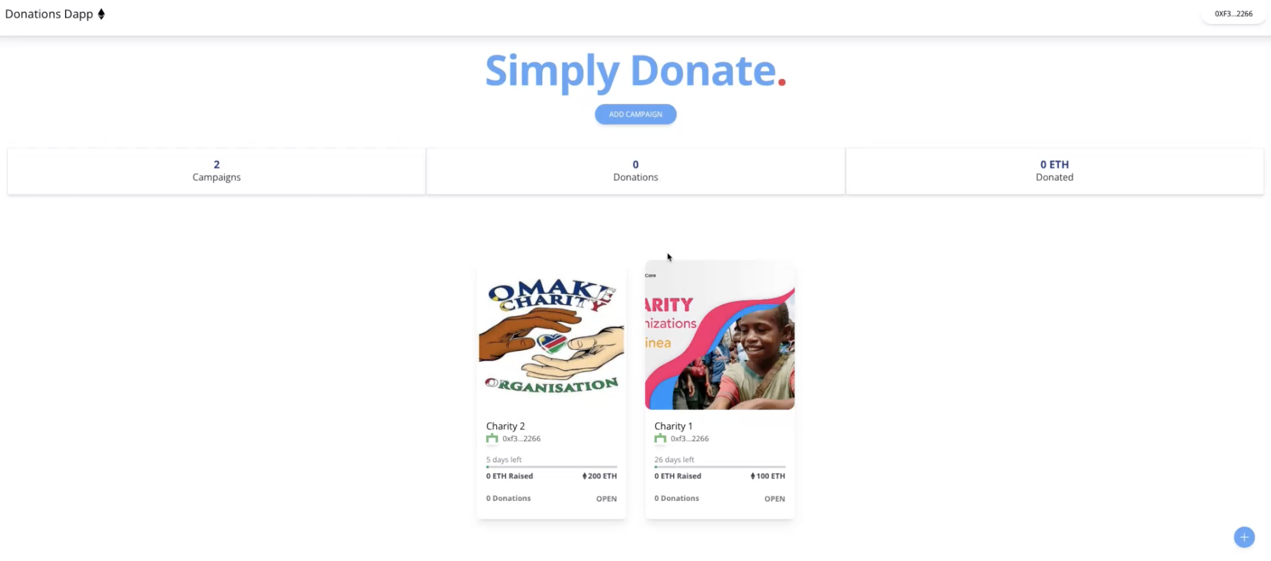
Screenshots
This is the main page of our DApp. Which you can see with 2 open for donations campaigns
and a unique address on the top right corner logged into MetaMask
MetaMask address
2 open campaigns

Slide 9
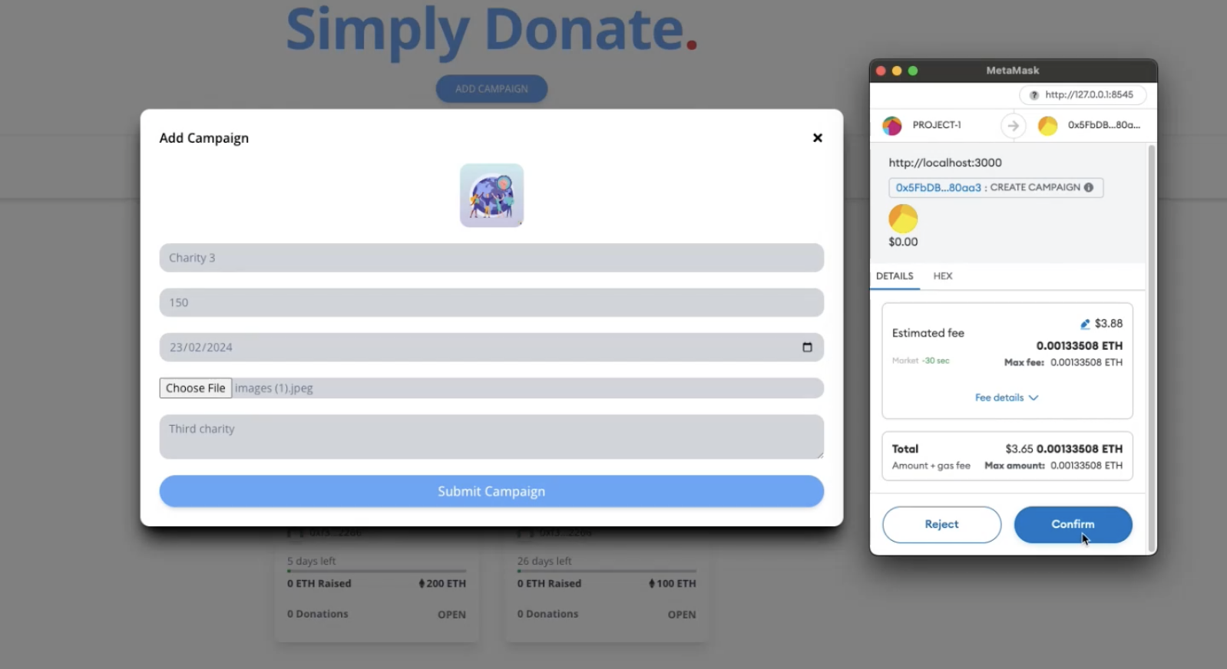
Screenshots
Here you can see the creation of campaign number 3
With the MetaMask popup to sign the transaction

Slide 10
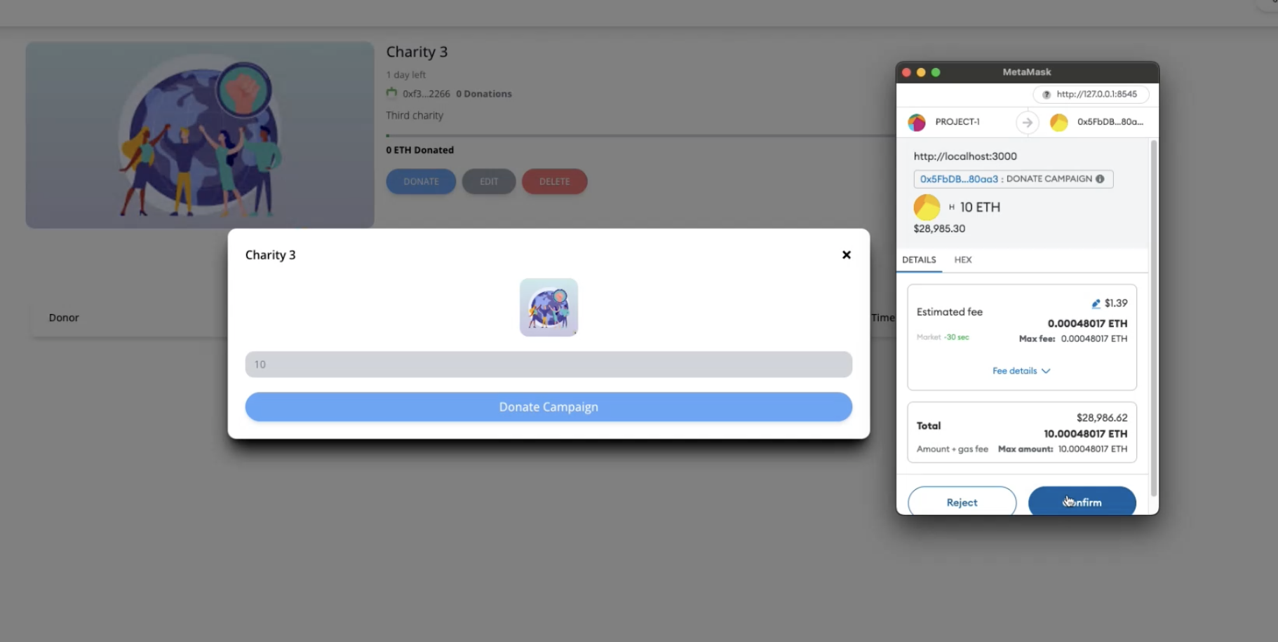
Screenshots
Here we are donating 10 ETH to campaign number 3
10 ETH donation

Slide 11
Screenshots
This is a screenshot from the Pinata website , our IPFS database
And you can see 3 different objects that represent the 3 different campaigns that is open on our DApp
Each object is the file image of each campaign
3 images

Slide 12
Project progress schedule
At first we made the system requirements/UML/ Class diagram to understand how we want to build our project.
It took us about 3-4 weeks which afterwards we immediately started working on the UI of the website and writing our smart contract at the same time. That alone took us another 1-2 months.
When our UI and smart contract were in place we integrated our IPFS database alongside the whole Backend development and started unit testing to make sure the code is polished.
Eventually after 3-4 months we managed to create the final product with each required document that captures the development process.
We set down with Roi approx. every two to 3 weeks , and every time we made sure all the meetings went smoothly , and we were right on time with our all of our tasks.

Slide 13
Unexpected problems
Unexpected problems that appeared during the implementation of the project
One of the main problem we faced was the IPFS database
First we wanted to use INFURA database but we had couple of issues:
- deploying the code
- infura themselves stopped the services while we were working on the code

Slide 14
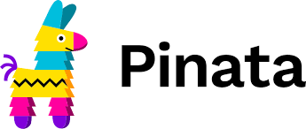
Coping and Solving
After some research we found Pinata , which is a different ipfs provider, we went through
Their documents fast and start coding right away. We found succcess using this platform and made sure every thing working properly.
Next page is the function we implemented

Slide 15
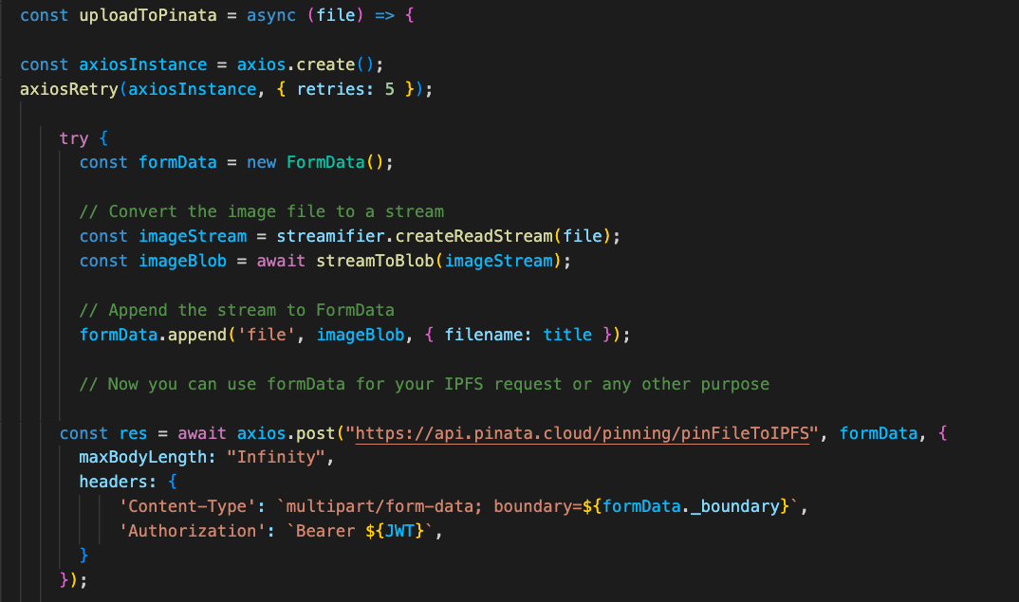
Coping and Solving
This is the code we eventually came up with that worked for us

Slide 16
Conclusions for further development
Achievements
Successful Smart Contracts: The implementation of smart contracts, including the CampaignFactory contract, showcased effective and secure handling of campaign-related functionalities.
User-Friendly Interface: The frontend design prioritized user experience, allowing for intuitive navigation and personalization of donation preferences.
Decentralized Data Storage: Integration with IPFS ensured decentralized and censorship-resistant storage of media files.
Security Measures: The implementation of role-based access control and digital signature verification contributed to the overall security of the platform.

Slide 17
Conclusions for further development
Lessons Learned
In the course of developing our decentralized charity and donation platform, key lessons emerged, showcasing our team's adaptability and technical growth.
Integrating IPFS for decentralized data storage taught us resilience and censorship resistance.
Connecting digital wallets, especially navigating MetaMask integration, provided insights into secure user interactions.
Mastery of React and Solidity deepened our understanding of frontend and smart contract development. Testing smart contracts, using frameworks like Truffle, emphasized the importance of reliability.
These experiences collectively fortified our team, laying a foundation for future decentralized application endeavors.

